Slide 1

How does traffic respond to tolling?
Deny Sullivan
HALIFAX | 13 December 2023

Slide 2
Who We Are
Robert Bain | Sylvain Senechal | Ben Cimon | Ben Cimon | Deny Sullivan
Focus: Commercial/Technical Due Diligence of Road + Rail
Engineer (PhD/CEng) | Modeller (MBA/CFA) | Economist (BSc Finance/CFA) |  | Economist/Modeller (BA/MA Econ.)
Ex-Standard & Poor’s | Ex-Brookfield
London-Based | Ottawa-Based |  |  | Halifax-Based
Strong Financial-Sector Backgrounds
Prepare/Review Demand & Revenue Forecasts
International Clients & Projects (top-20 infra investors)
Expert Witness: Litigation & Arbitration

Slide 3









































Our Clients

Slide 4
Research Question
How does traffic respond to the start (or end) of road user charging?
The Investor’s question:
  How much traffic/revenue will be lost once the road is tolled?
The transportation planner's question:
  How might tolls reduce congestion and infrastructure needs?

Slide 5
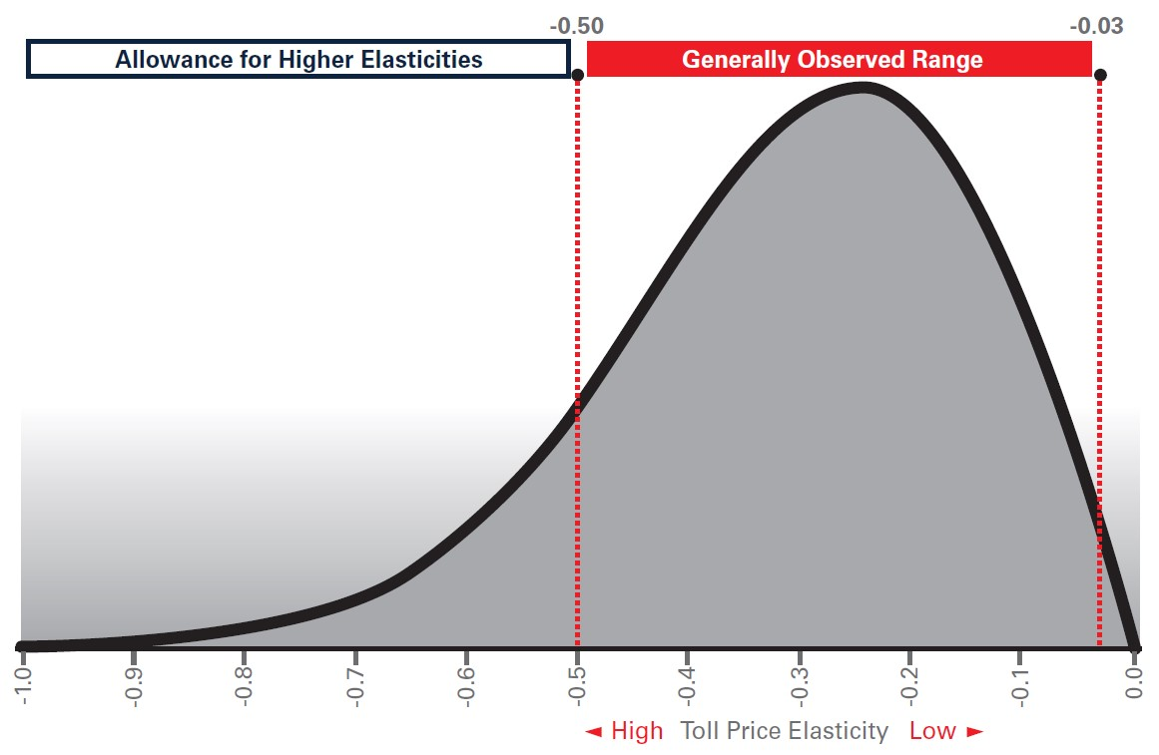
Background: Price Elasticity
Price elasticity has a literature
Vehicle traffic is inelastic on the margin (-0.1 to -0.3)
Spoiler: Tolling impacts are large vs. elasticity
  “power of free”

Slide 6
Background: Traffic Modelling
Traffic models are imprecise
  Sound familiar?
Traffic models rely on complex interactions of inputs and assumptions

Slide 7
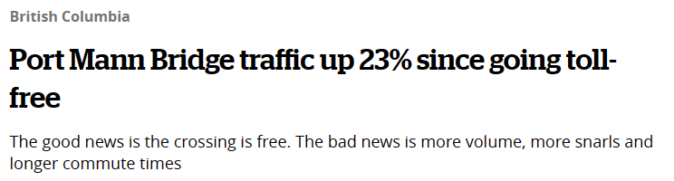
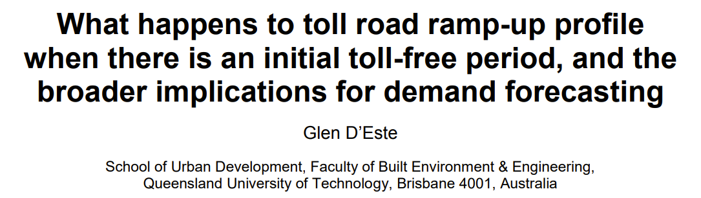
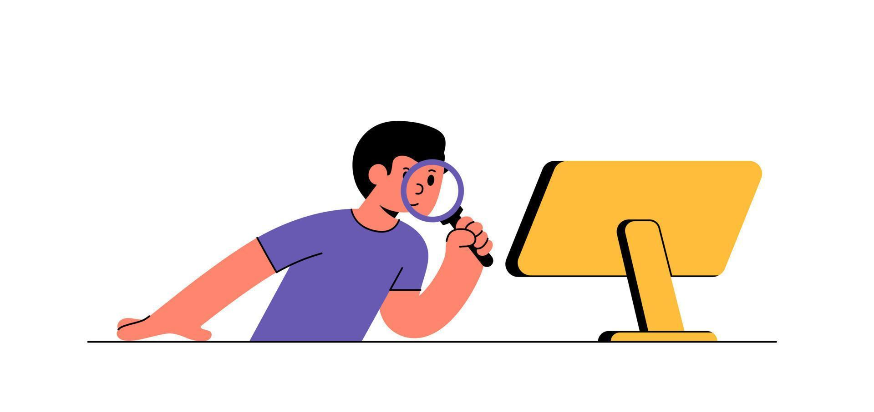
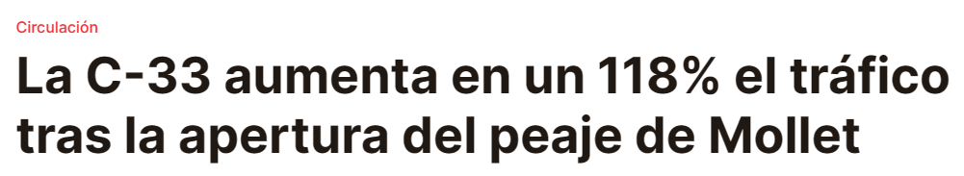
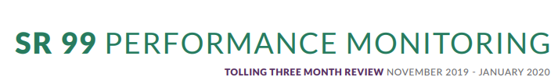
Data Collection
Public toll road data is rare
Collected data from:
  Media articles
  Government reports
  Academic / practitioner research
  Traffic counts / client data

Slide 8
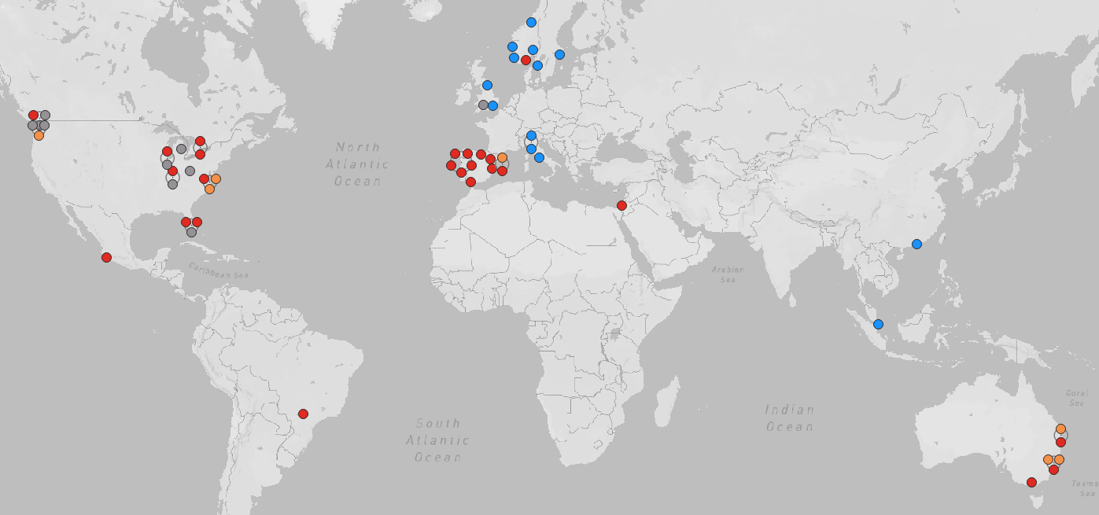
Dataset
56 data points across 14 countries
Bridge
Cordon
Road
Tunnel

Slide 9
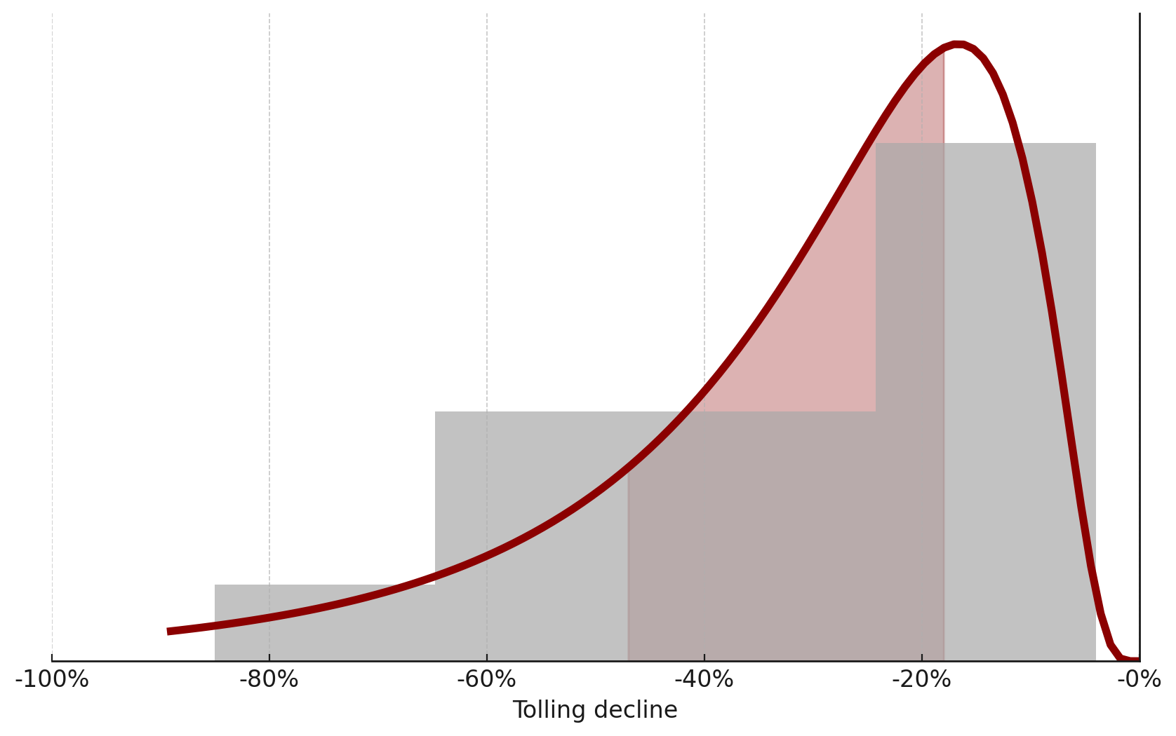
Distribution of results
Traffic declines from tolling often range between -20% and -45%
-18%
Median
-28%
-46%

Slide 10
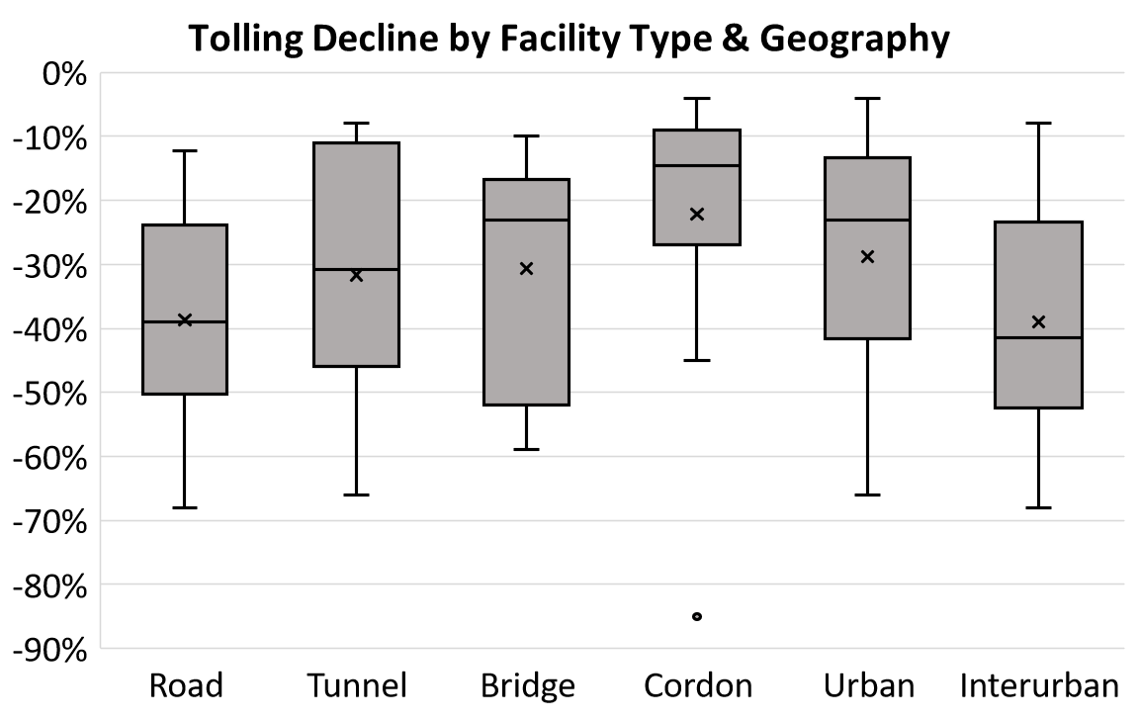
Summary statistics
Modest differences by facility & geography type, but wide variation everywhere

Slide 11
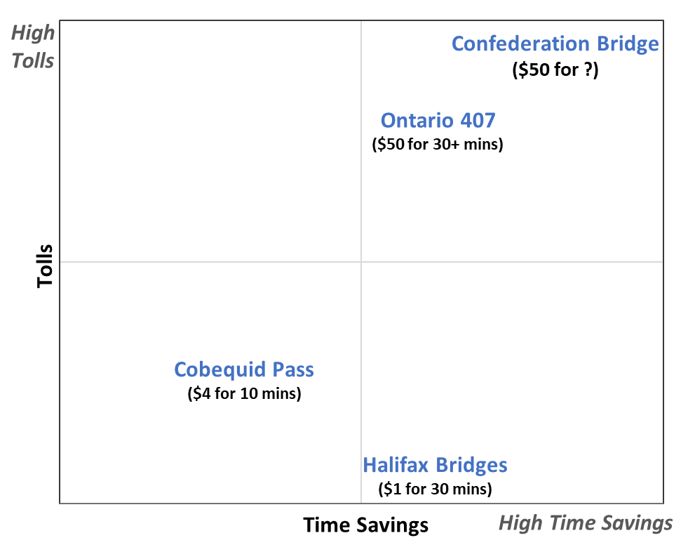
It’s about time
Drivers do cost-benefit calculations when deciding to use toll roads
High tolls vs. time saved will decline most from tolling (or vice-versa)
  Testing for this has issues…
“Cost per Minute Saved” Illustration

Slide 12
Where did the cars go?
Carpooling
Change of route
  Spain always has a toll-free parallel road
Change of mode
  London congestion boosted bus traffic 30%
Change of destination
  Sanibel Causeway in Florida attracting weekend beach-goers
Trip destruction
  Seattle SR-99: Half of the decline in traffic not seen on other roads or buses

Slide 13
Conclusions
Investors should be cautious investing in “about to be tolled” facilities
  …and governments should not auction roads until they are tolled
Many drivers on the road are not willing to pay directly to use the road
Congestion pricing could have greater effects than expected
  Tolling is usually set for cost-recovery

