Slide 1
Atlantic Association of Applied Economists Student Panel
Private Sector Pay Equity Legislation and the Marginalised Pay Gap(s) in Canada
Yeshwin Ayappa M.P.
B.Sc. Economics
0

Slide 2
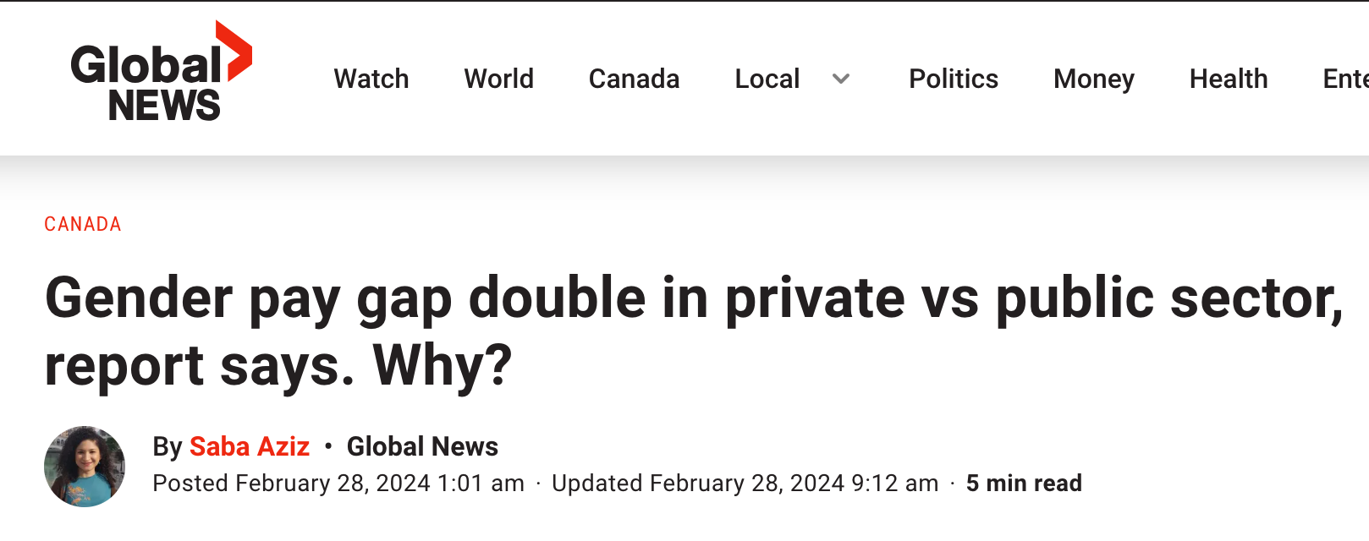
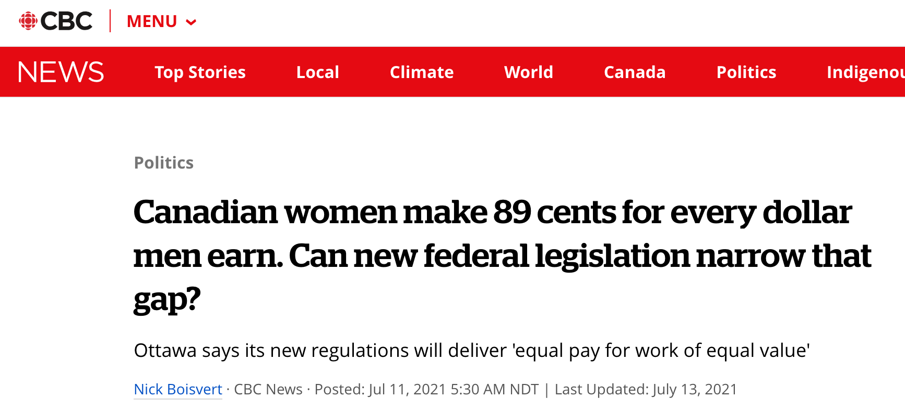
Background
Pay Inequity
Background | Research Question | Empirical Strategy | Findings | Conclusion

Slide 3
Background
The Pay Equity Act (2018)
Women earned only 89 cents for every dollar earned by men (Statistics Canada, 2022).
Private sector gender pay-gap 2x public sector (Global News, 2024).
Immigrants wages 20% lower than Canadian-born peers. (The Conference Board of Canada)
The Pay Equity Act passed on December 13, 2018 and in effect August 31, 2021 requires federally regulated employers with 10 or more employees to take a proactive approach to pay equity.
Note: The ACT meant to address the gender pay-gay only.
Background | Research Question | Empirical Strategy | Findings | Conclusion

Slide 4
Research Question
Variables of Interest
How did the Pay Equity Act (2018) affect pay-gaps for marginalised groups in the federally regulated private sector?
Background | Research Question | Empirical Strategy | Findings | Conclusion

Slide 5
Empirical Strategy
Causal Effect Estimation
Difference-in-differences
log(wage)= 𝛼 + 𝜏Treatment +𝜆Post +𝛽₀DiD +𝜎Group +𝛽₁T*G +𝛽₂P*G +𝛽₃DiD*Group +𝛽₄X’ +𝜀
The Coefficient of interest 𝛽₃ , represents the degree (%) of change in the pay-gap in the federally regulated private sector relative to the unregulated private sector.
Event Study
The study is augmented to a dynamic difference-in-differences (i.e., event study) framework, to test for pre trends and estimate how the pay-gap evolved over time.
Background | Research Question | Empirical Strategy | Findings | Conclusion

Slide 6
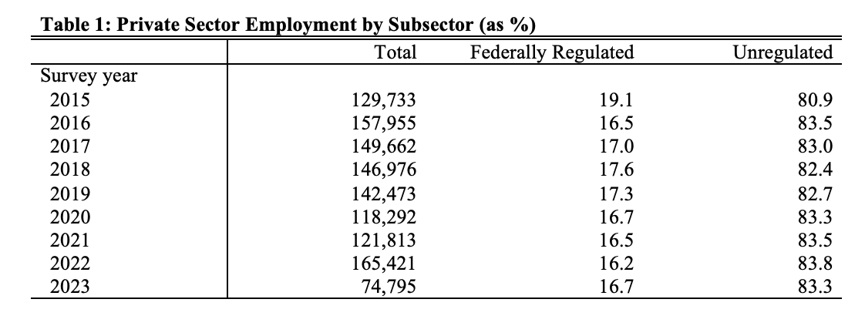
Empirical Strategy
Data (LFS- January 2015 to June 2023)
Federally Regulated (Treatment Group)
Transport/Warehousing
Info/Culture/Rec
< 19.1% of Private Sector Employment
Unregulated (Control Group)
Manufact Non-Durables
Wholesale Trade
Retail Trade
Finance/Insurance/R. Estate
Prof/Scient/Technical
Mngmnt/Admin/Other
Other Services
Background | Research Question | Empirical Strategy | Findings | Conclusion

Slide 7
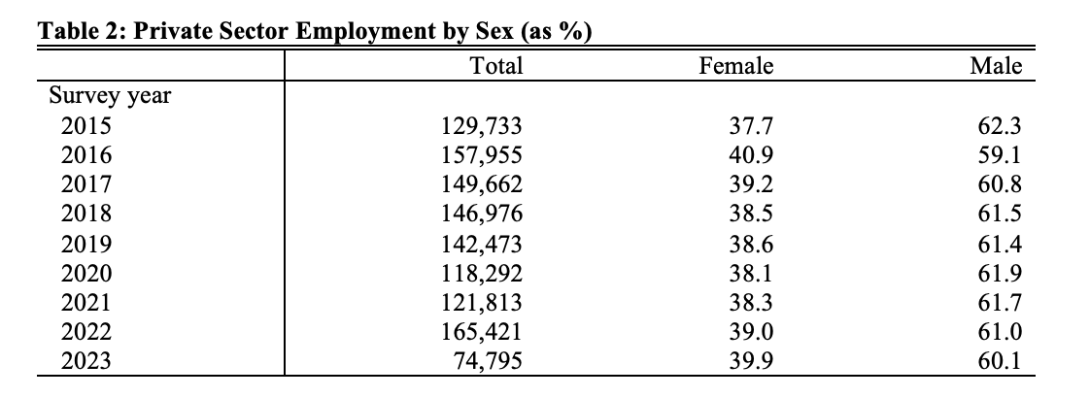
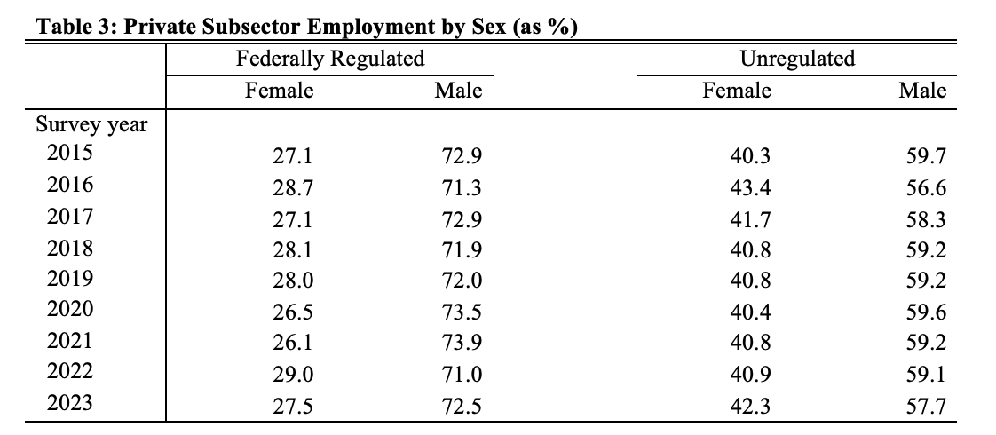
Empirical Strategy
Data (LFS- January 2015 to June 2023)
Private Sector
Female employment < 40.9%
Federally Regulated
Female employment < 29.0%
Unregulated
Female employment < 43.4%
Background | Research Question | Empirical Strategy | Findings | Conclusion

Slide 8
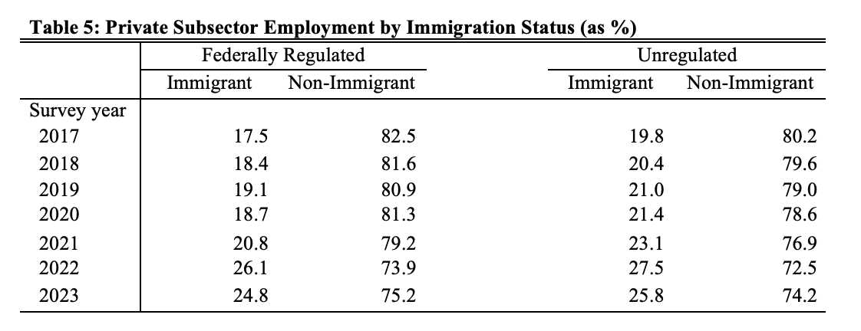
Empirical Strategy
Data (LFS- January 2017 to June 2023)
Private Sector
Immigrant employment < 27.3%
Federally Regulated
Immigrant employment < 26.1%
Unregulated
Immigrant employment < 27.5%
Background | Research Question | Empirical Strategy | Findings | Conclusion

Slide 9
Findings
Effect on Female Wages
II. Effect on Immigrant Wages
III. Effect on Regulated Sector Wages
Background | Research Question | Empirical Strategy | Findings | Conclusion

Slide 10
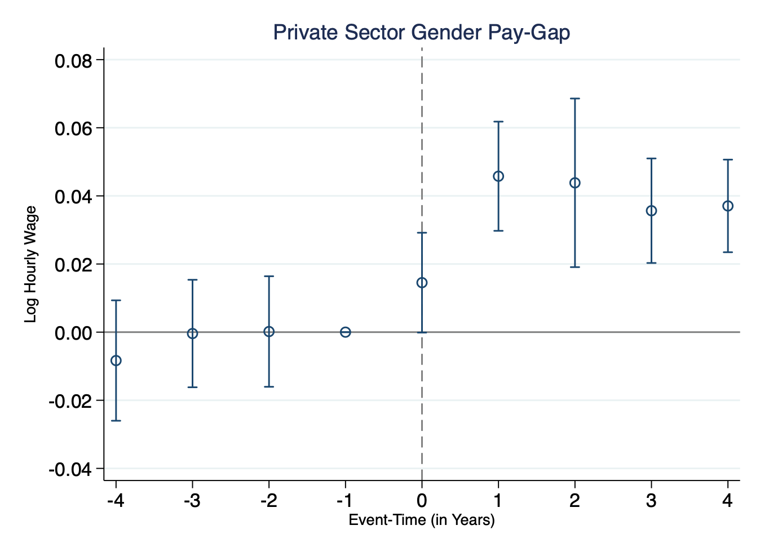
Findings I: Effect on Female Wages
Gender pay-gap in the ‘federally regulated’ private sector (relative to the unregulated) has continued to contract YoY since the law was passed.
Figure 1.
Background | Research Question | Empirical Strategy | Findings | Conclusion

Slide 11
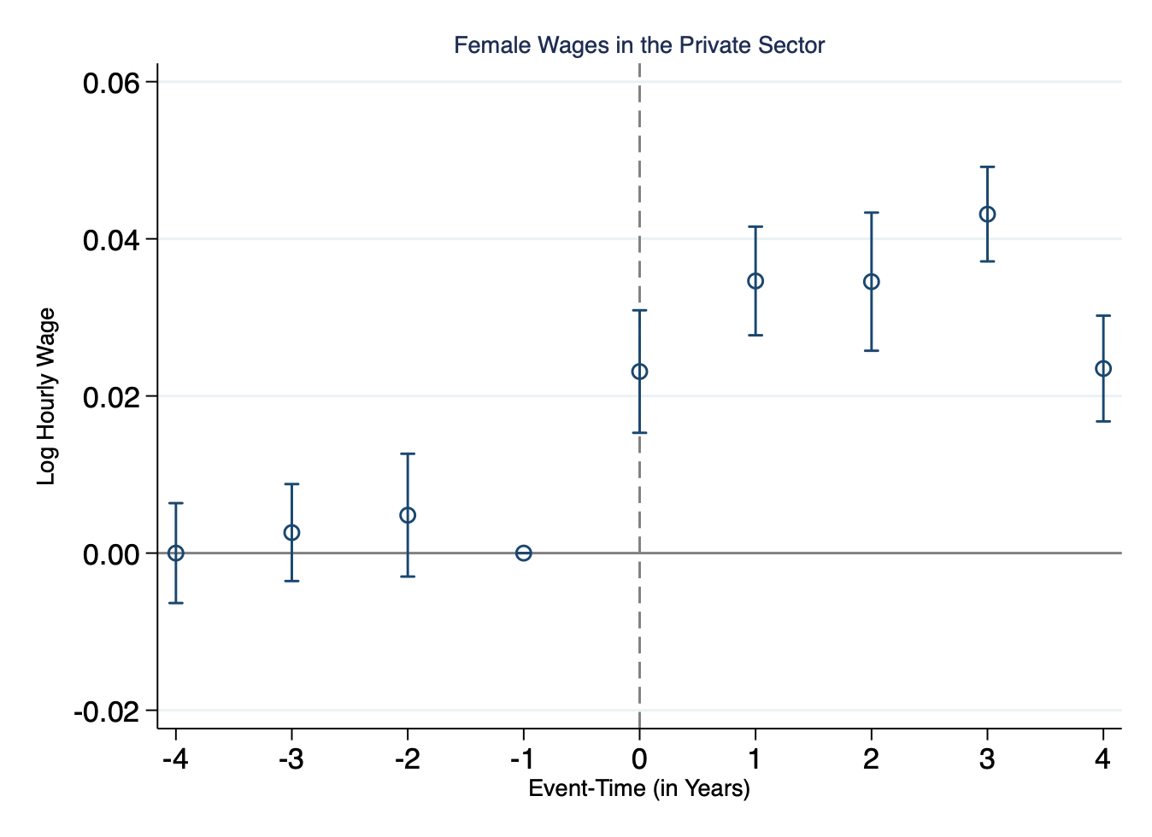
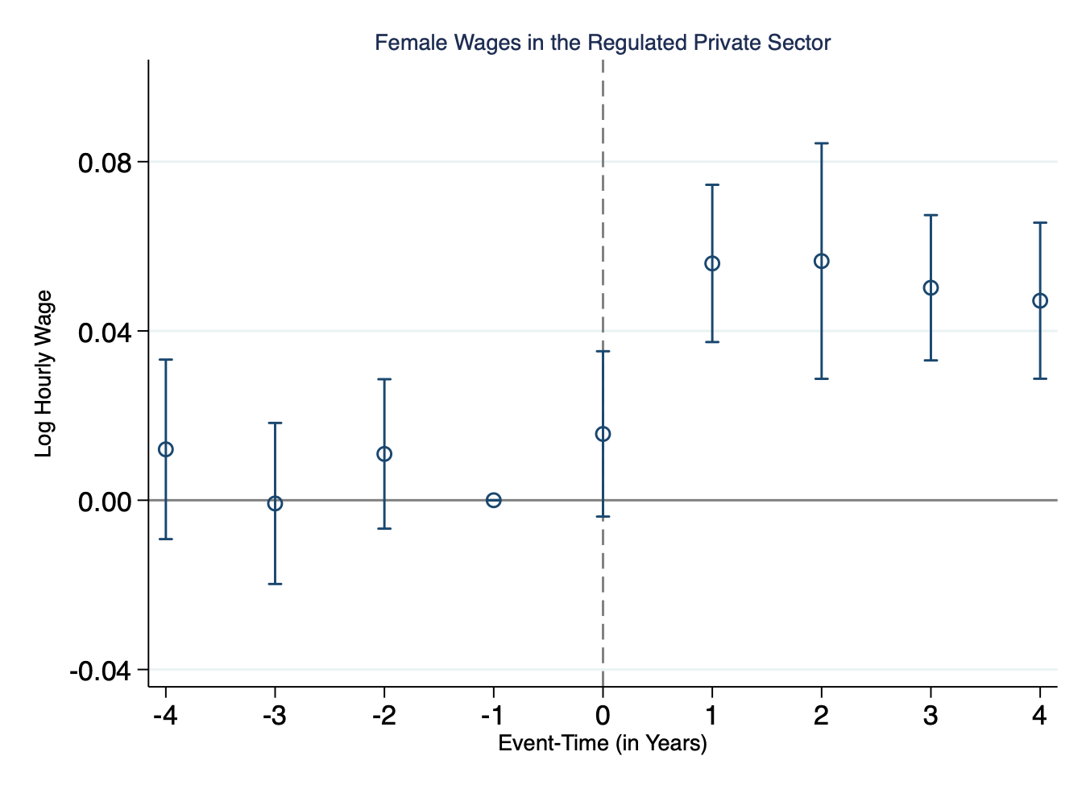
Findings I: Effect on Female Wages
Figure 2.
Figure 3.
Female wages in the private sector (relative to male wages) has continued to grow since the passage of the Pay Equity Act.
Female wages in the ‘federally regulated’ private sector (relative to male wages) has continued to grow since the Act’s passage.
Background | Research Question | Empirical Strategy | Findings | Conclusion

Slide 12
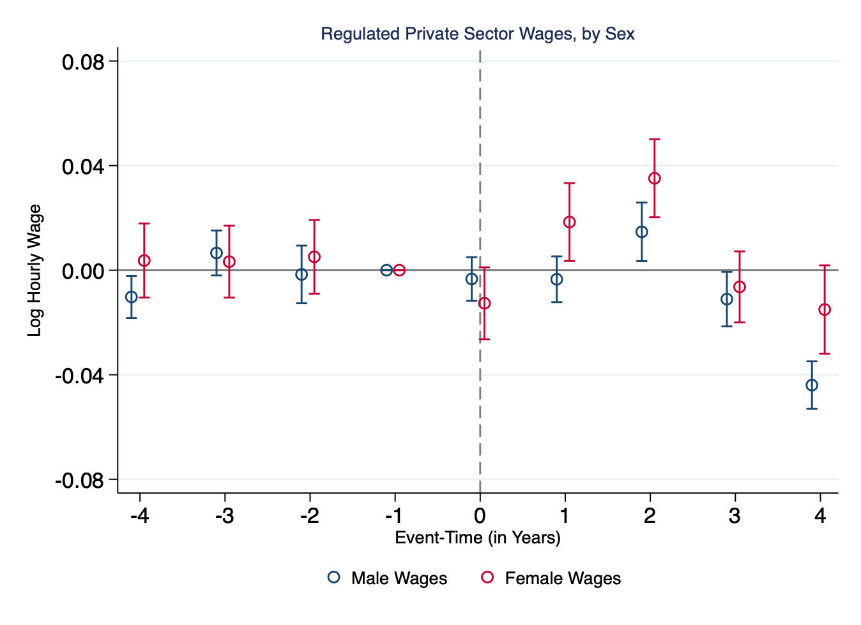
Findings I: Effect on Female Wages
Male wages in the regulated sector (relative to male wages in the unregulated sector) contracted by over 4% in 2023.
Similarly, female wages increased by 2% and 4% in 2021 and 2022.
Figure 4.
Background | Research Question | Empirical Strategy | Findings | Conclusion

Slide 13
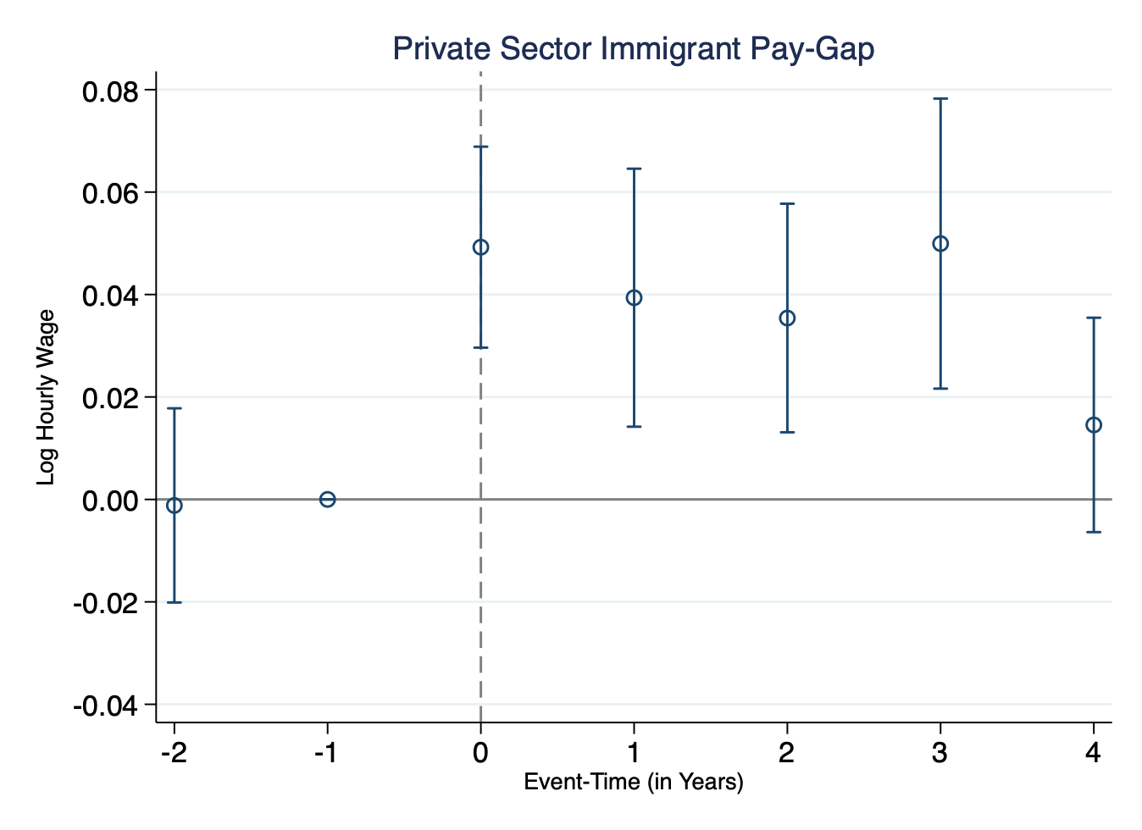
Findings II: Effect on Immigrant Wages
The pay-gap in the regulated sector, relative to the unregulated, contracted substantially for 3 years post treatment, before falling in line.
Figure 5.
Background | Research Question | Empirical Strategy | Findings | Conclusion

Slide 14
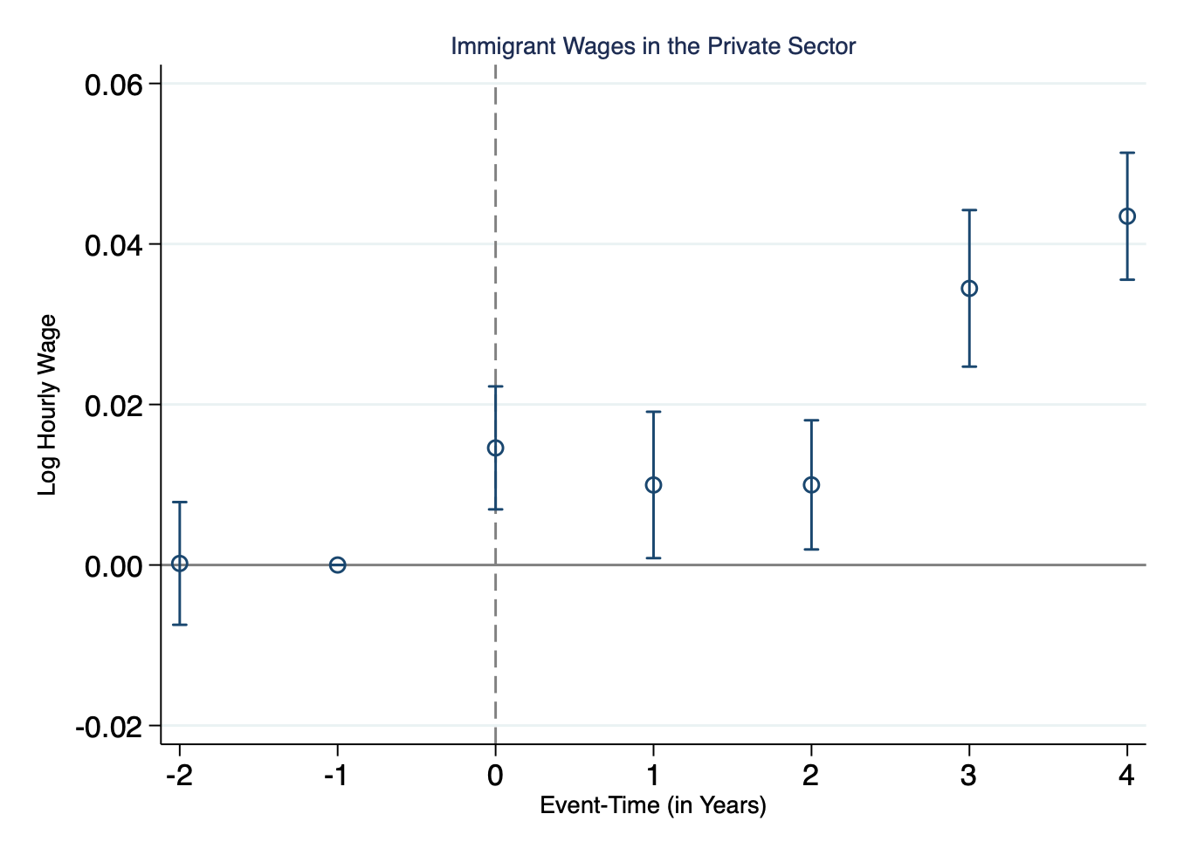
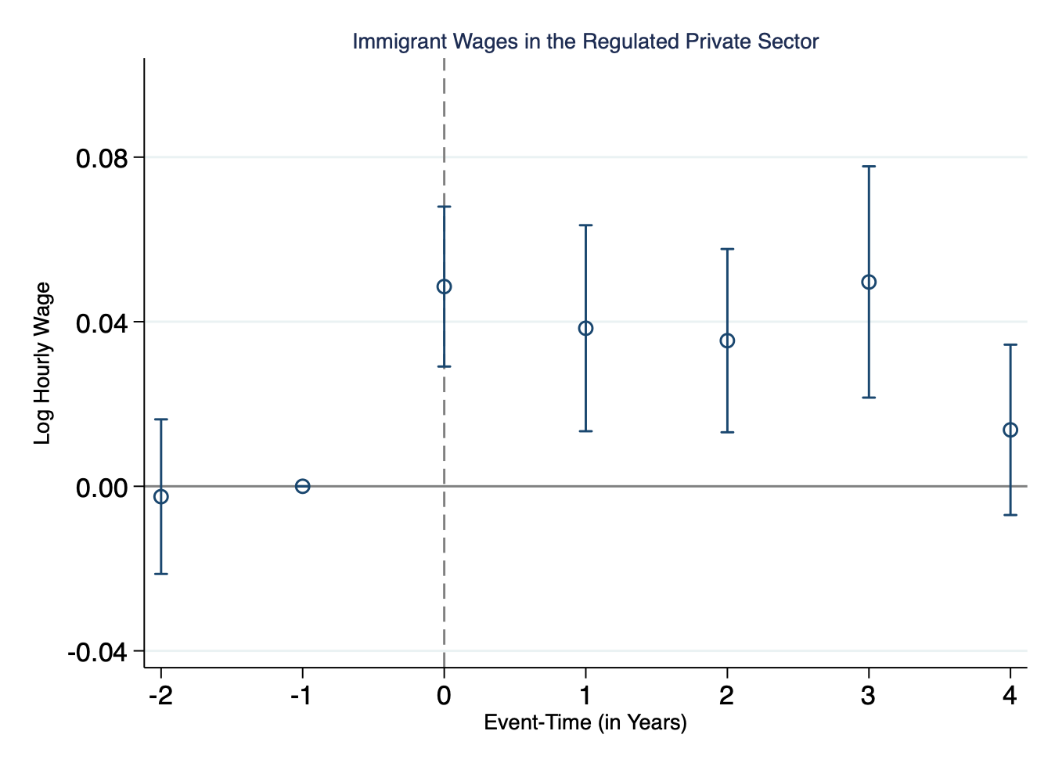
Findings II: Effect on Immigrant Wages
Figure 6.
Figure 7.
Relative to non-immigrants, immigrant wages have continued to grow YoY in the private sector, post treatment.
Relative to non-immigrants, immigrant wages in the regulated private sector continued to grow until 3 years post treatment (2022).
Background | Research Question | Empirical Strategy | Findings | Conclusion

Slide 15
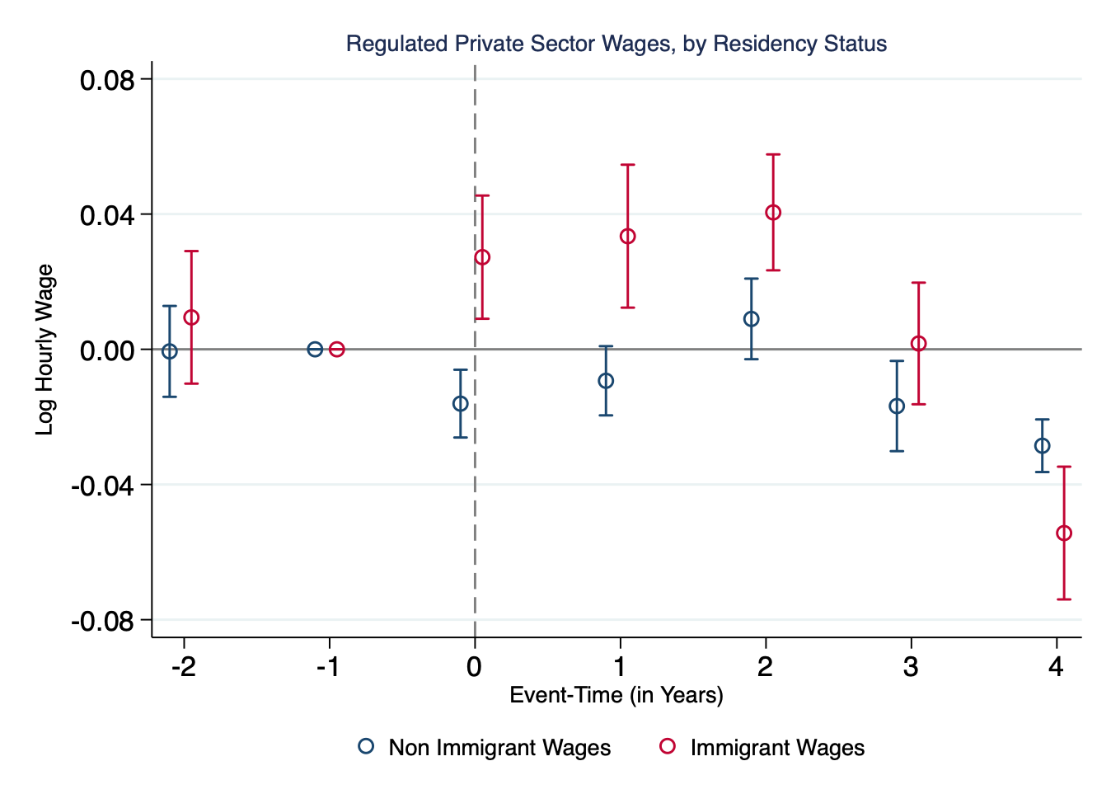
Findings II: Effect on Immigrant Wages
Non-immigrant wages in the federally regulated sector trended similarly to the unregulated.
Immigrant wages grew faster until 3 years post treatment.
Figure 8.
Background | Research Question | Empirical Strategy | Findings | Conclusion

Slide 16
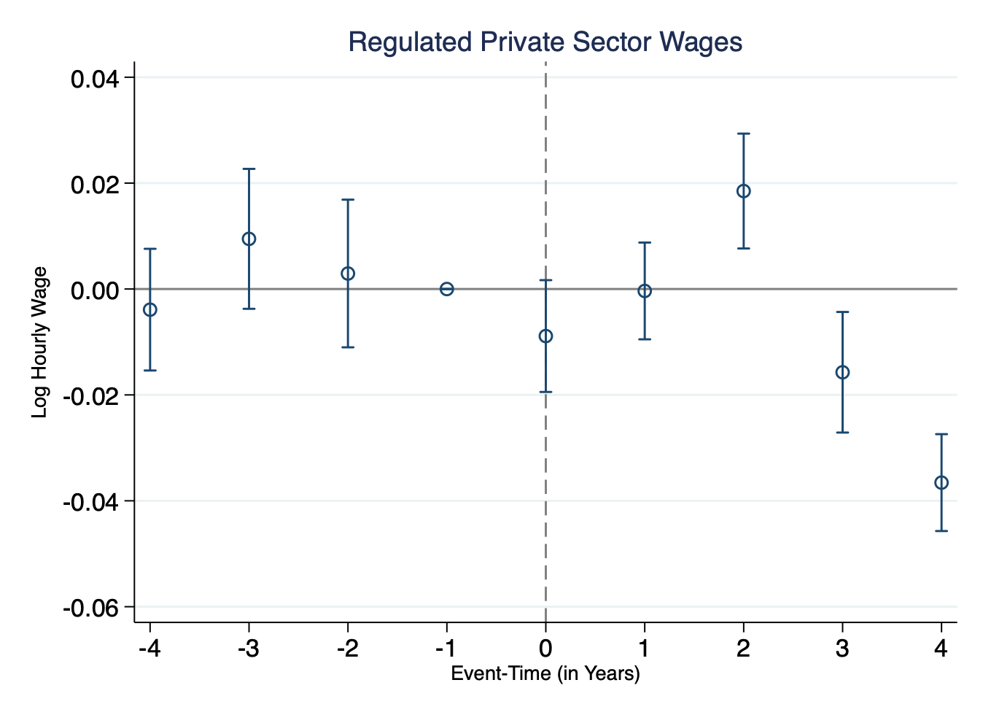
Findings III: Effect on Regulated Sector Wages
Averages wages in the ‘federally regulated’ private sector, relative to the ‘unregulated’ private sector grew 2% faster, 2 years post treatment.
Average wage growth contracted by approx. 2% and 4% in 2022 and 2023, respectively.
Figure 9.
Background | Research Question | Empirical Strategy | Findings | Conclusion

Slide 17
Conclusion
Net effect of the Act was to depress wage growth in the federally regulated private sector.
Relative to male wages, female wages grew substantially in the federally regulated private sector.
The gender pay-gap in the regulated contracted substantially YoY.
However, this contraction was largely driven by slower growth in male wages.
Immigrant wages grew substantially in the federally regulated private sector.
The immigrant pay-gap in the regulated sector contracted substantially post treatment.
The contraction was however driven by faster growth of immigrant wages. Non-immigrant wage growth was largely unaffected by the legislation.
Background | Research Question | Empirical Strategy | Findings | Conclusion

Slide 18
Atlantic Association of Applied Economists Student Panel
Private Sector Pay Equity Legislation and the Marginalised Pay Gap(s) in Canada
Yeshwin Ayappa M.P.
B.Sc. Economics
17

Slide 19
References
Bennedsen, M., Larsen, B., & Wei, J. (2023). Gender wage transparency and the gender pay gap: A survey. Journal of Economic Surveys, 37(5), 1743–1777. https://doi.org/10.1111/joes.12545
Blundell, J. (2021). Wage Responses to Gender Pay Gap Reporting Requirements. CEP Discussion Paper, no. 1750. London: London School of Economics and Political Science.
Cornish, M. (1996). Employment and Pay Equity in Canada--Success Brings Both Attacks and New Initiatives. Case Western Reserve University School of Law Scholarly Commons, 22 Can.-U.S. L.J. 265. https://scholarlycommons.law.case.edu/cuslj/vol22/iss/35
Statistics Canada. (2022). Pay gap, 1998 to 2021. Quality of Employment in Canada, 14-28-0001-X. https://www150.statcan.gc.ca/n1/pub/14-28-0001/2020001/article/00003-eng.htm
Blau, Francine D., and Lawrence M. Kahn. “The Gender Wage Gap: Extent, Trends, and Explanations.” Journal of Economic Literature 55, no. 3 (2017): 789–865. http://www.jstor.org/stable/26303306.
Chowhan, J., Zeytinoglu, I. U., & Cooke, G. B. (2012). Are Immigrants’ Pay and Benefits Satisfaction Different than Canadian-born? Relations Industrielles / Industrial Relations, 67(1), 3–24. http://www.jstor.org/stable/41634301
Kaushal, N., Lu, Y., Denier, N., Wang, J. S.-H., & Trejo, S. J. (2016). Immigrant employment and earnings growth in Canada and the USA: evidence from longitudinal data. Journal of Population Economics, 29(4), 1249–1277. http://www.jstor.org/stable/44280431
PICOT, G., & HOU, F. (2018). Immigrant STEM Workers in the Canadian Economy: Skill Utilization and Earnings. Canadian Public Policy / Analyse de Politiques, 44(S1), S113–S124. https://www.jstor.org/stable/90026548
Hodgins, J. (2023). The clock is ticking: Federal employers to post pay equity plans by September 3, 2024. Norton Rose Fulbright. https://www.nortonrosefulbright.com/en-ca/knowledge/publications/e66e132e/the-clock-is-ticking-federal-employers-to-post-pay-equity-plans-by-september-3-2024
Aziz, S. (2024). Gender pay gap double in private vs public sector, report says. Why?. Global News. https://globalnews.ca/news/10320571/gender-pay-gap-private-vs-public-sector-report/
The Facts about the Gender Pay Gap. Canadian Women’s Foundation. https://canadianwomen.org/the-facts/the-gender-pay-gap/.
Drolet, M. & Mardare, M. A. (2023). Intersectional Perspective on the Canadian Gender Wage Gap. Studies on Gender and Intersecting Identities, Statistics Canada, Catalogue no. 45200002. https://www150.statcan.gc.ca/n1/pub/45-20-0002/452000022023002-eng.htm
Untapped Potential: Canada Needs to Close Its Immigrant Wage Gap. RBC Capital Markets. https://www.rbccm.com/en/insights/story.page?dcr=templatedata%2Farticle%2Finsights%2Fdata%2F2019%2F10%2Funtapped_potential_canada_needs_to_close_its_immigrant_wage_gap
(2016). Immigrant Wage Gap. The Conference Bank of Canada. https://www.conferenceboard.ca/hcp/immigrant-gap-aspx/
(2024). Canada’s gender and immigration pay gap narrowing in the public sector. Employment and labour. https://policyalternatives.ca/newsroom/news-releases/canada%E2%80%99s-gender-and-immigration-pay-gap-narrowing-public-sector-0#:~:text=The%20report%20finds%20that%20the,cent%20less%20than%20Canadian%20citizens.
Background | Research Question | Empirical Strategy | Findings | Conclusion

Slide 20
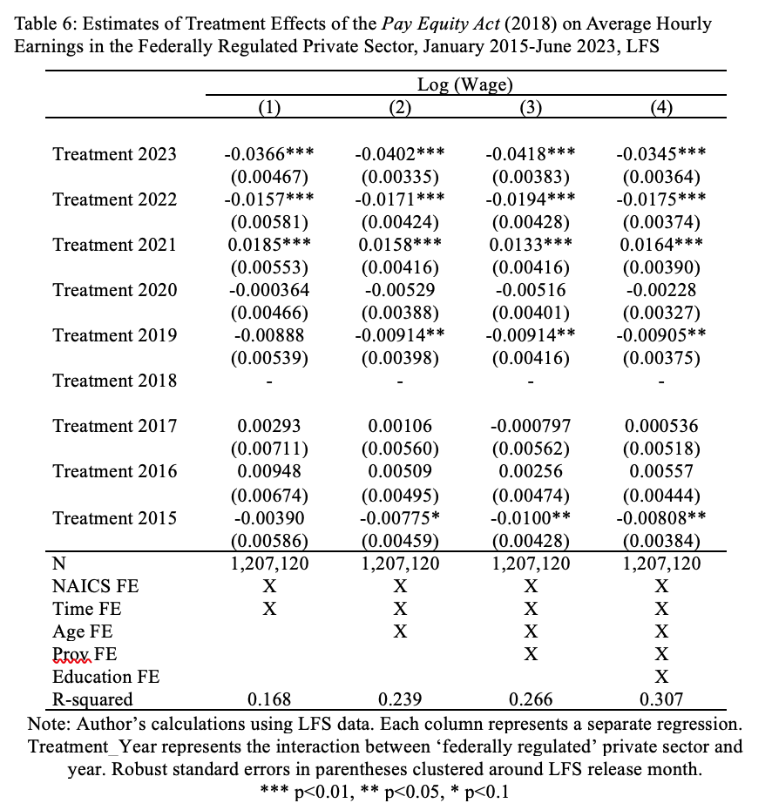
Appendix
Background | Research Question | Empirical Strategy | Findings | Conclusion

Slide 21
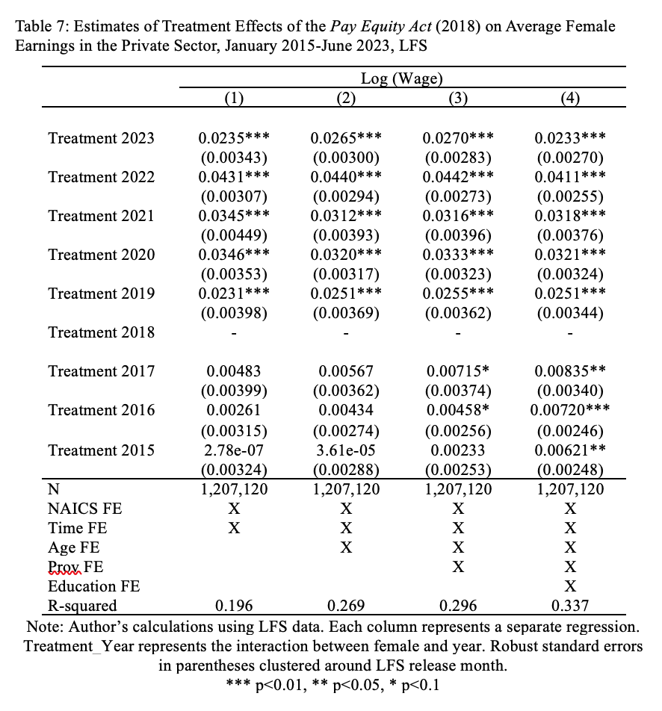
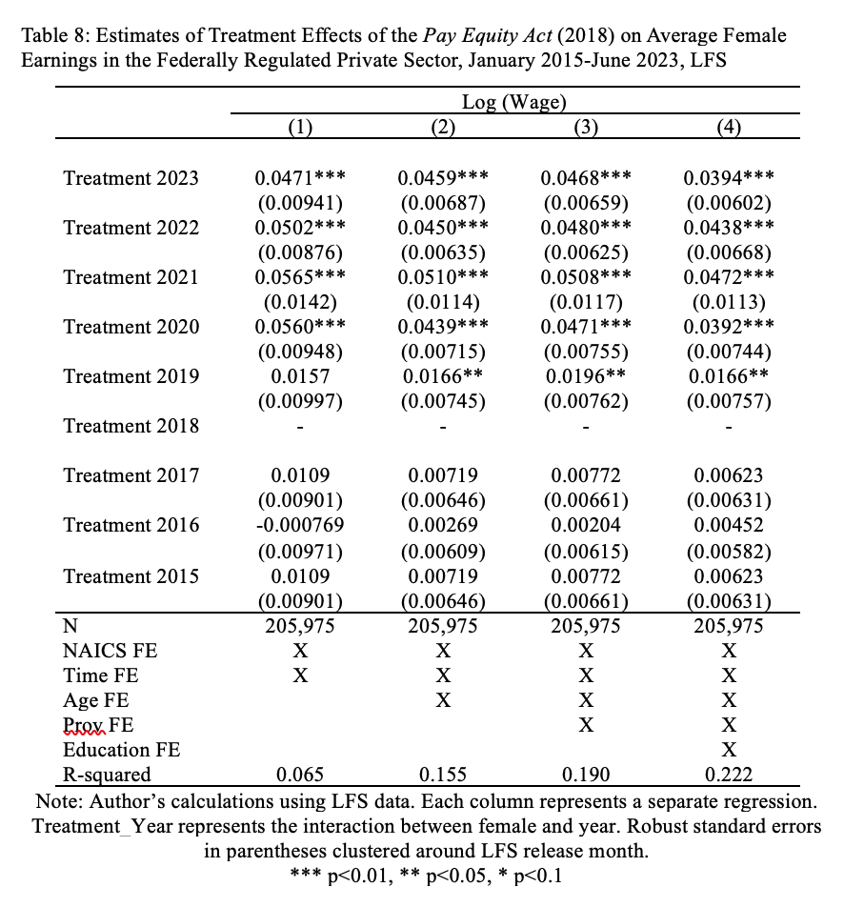
Appendix
Background | Research Question | Empirical Strategy | Findings | Conclusion

Slide 22
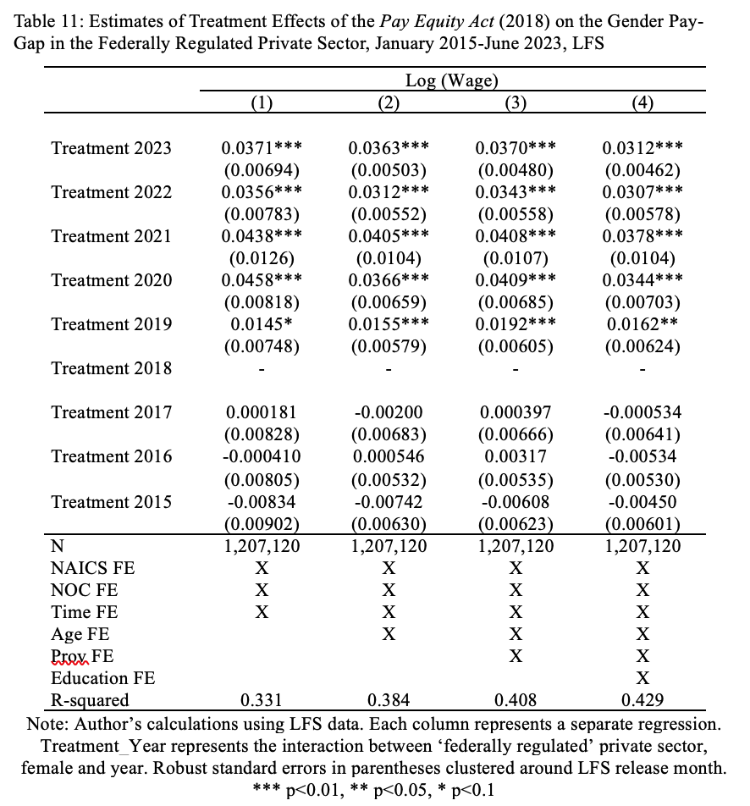
Appendix
Background | Research Question | Empirical Strategy | Findings | Conclusion

Slide 23
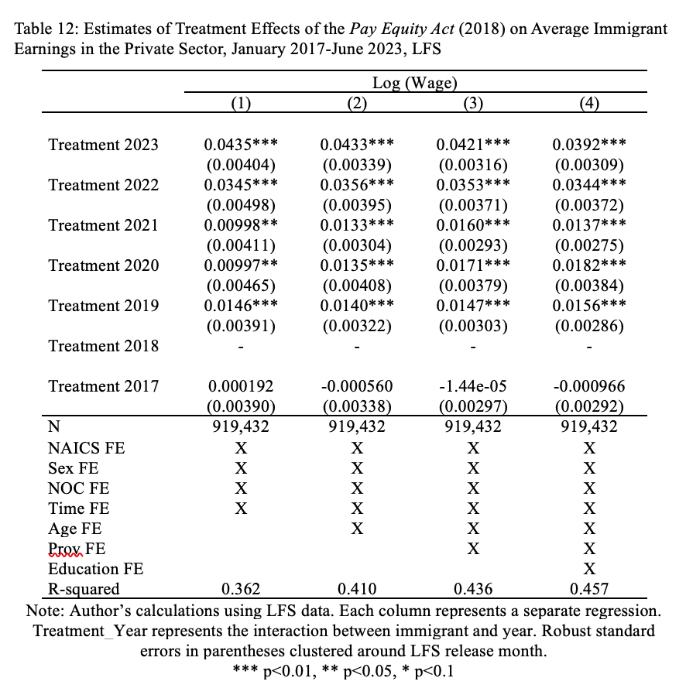
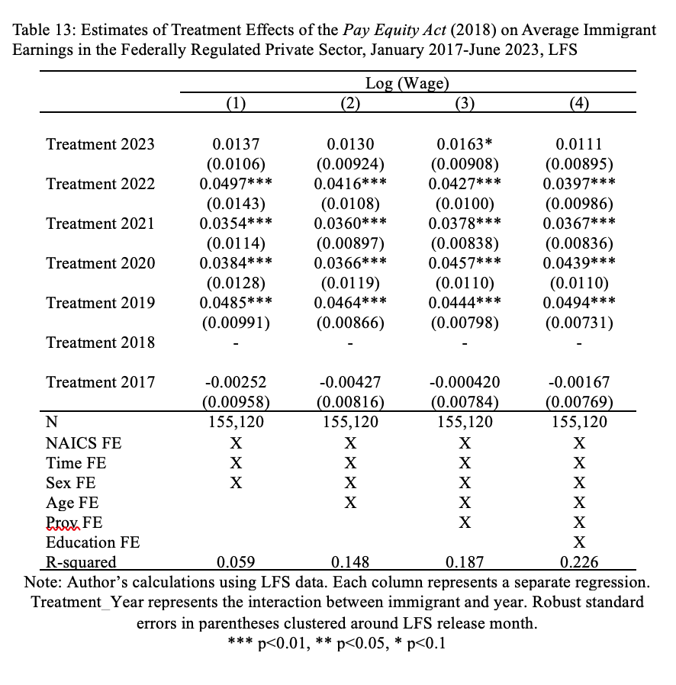
Appendix
Background | Research Question | Empirical Strategy | Findings | Conclusion

Slide 24
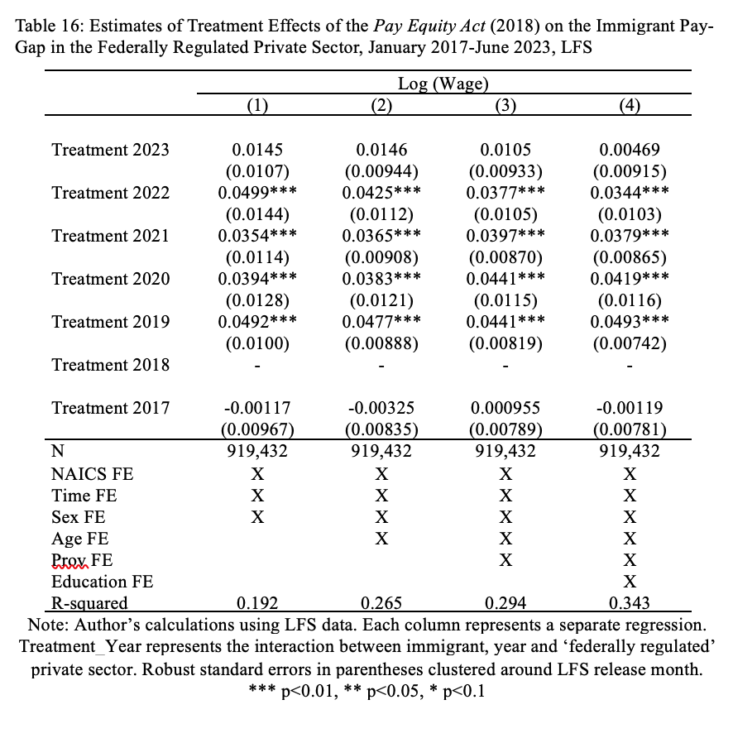
Appendix
Background | Research Question | Empirical Strategy | Findings | Conclusion

