Slide 1
Wildfire Impact on Halifax Housing Prices: A Hedonic Analysis
Chen Zhang
AAAE Student Panel March 22nd, 2024

Slide 2
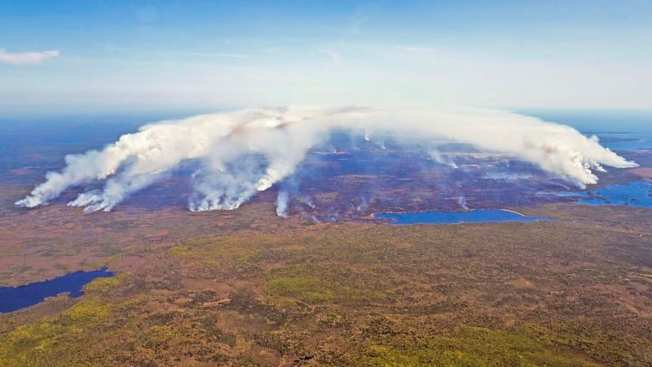
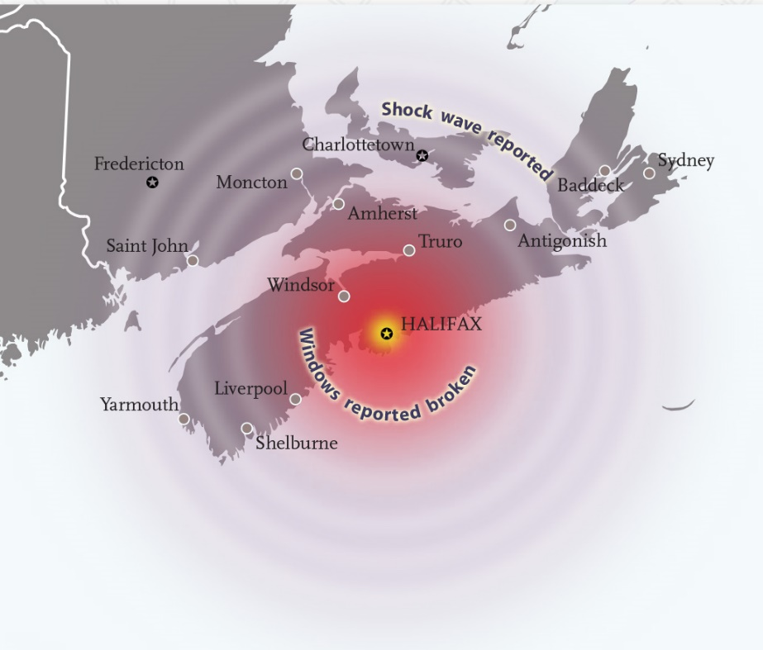
Halifax wildfire in May 2023
(CBC News)
(canadiangeographic.ca)

Slide 3
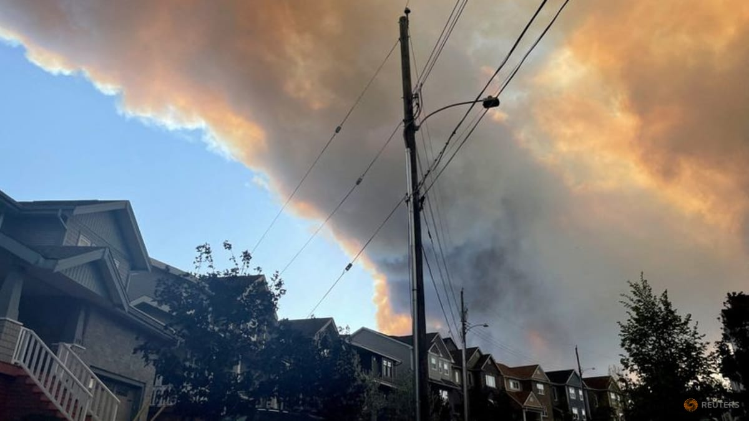
Damage and Destruction
Increased Risk Perception
Higher Insurance Costs
Infrastructure and Service Disruption
Community and Demographic Changes
(todayonline.com)
How do wildfires affect housing prices in Halifax, Nova Scotia?

Slide 4
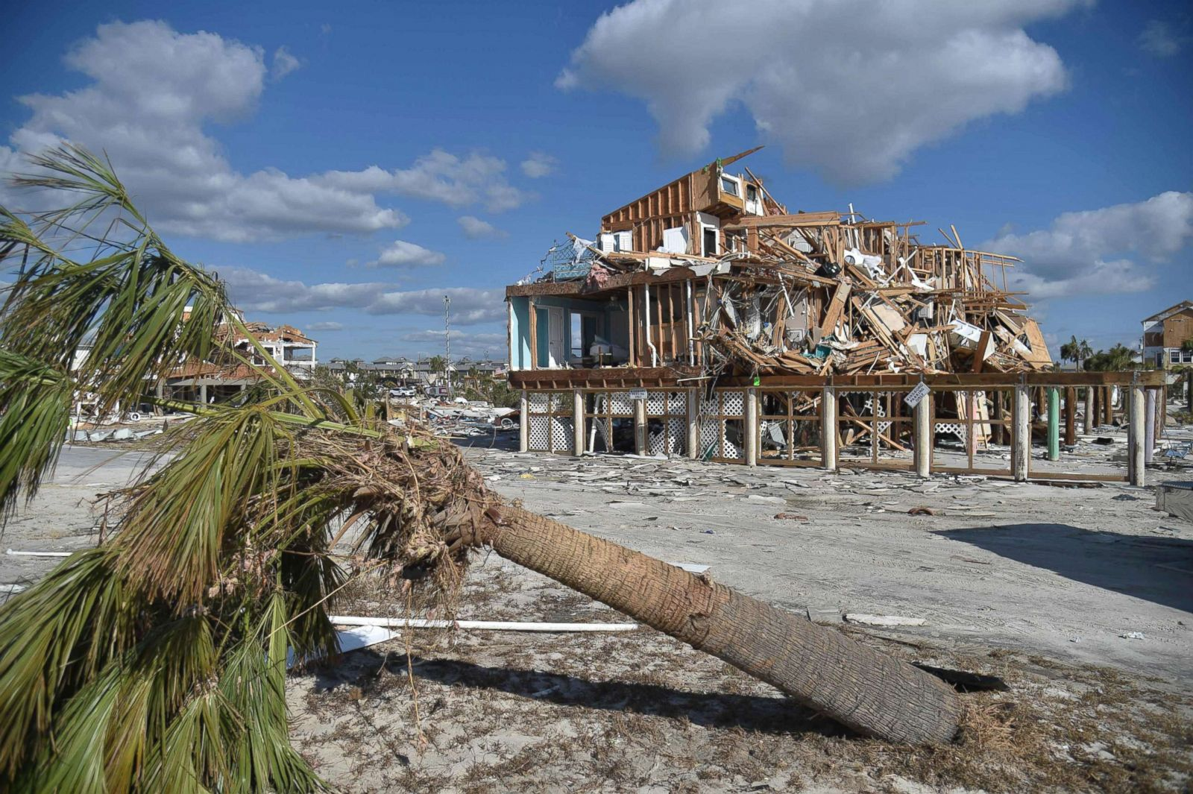
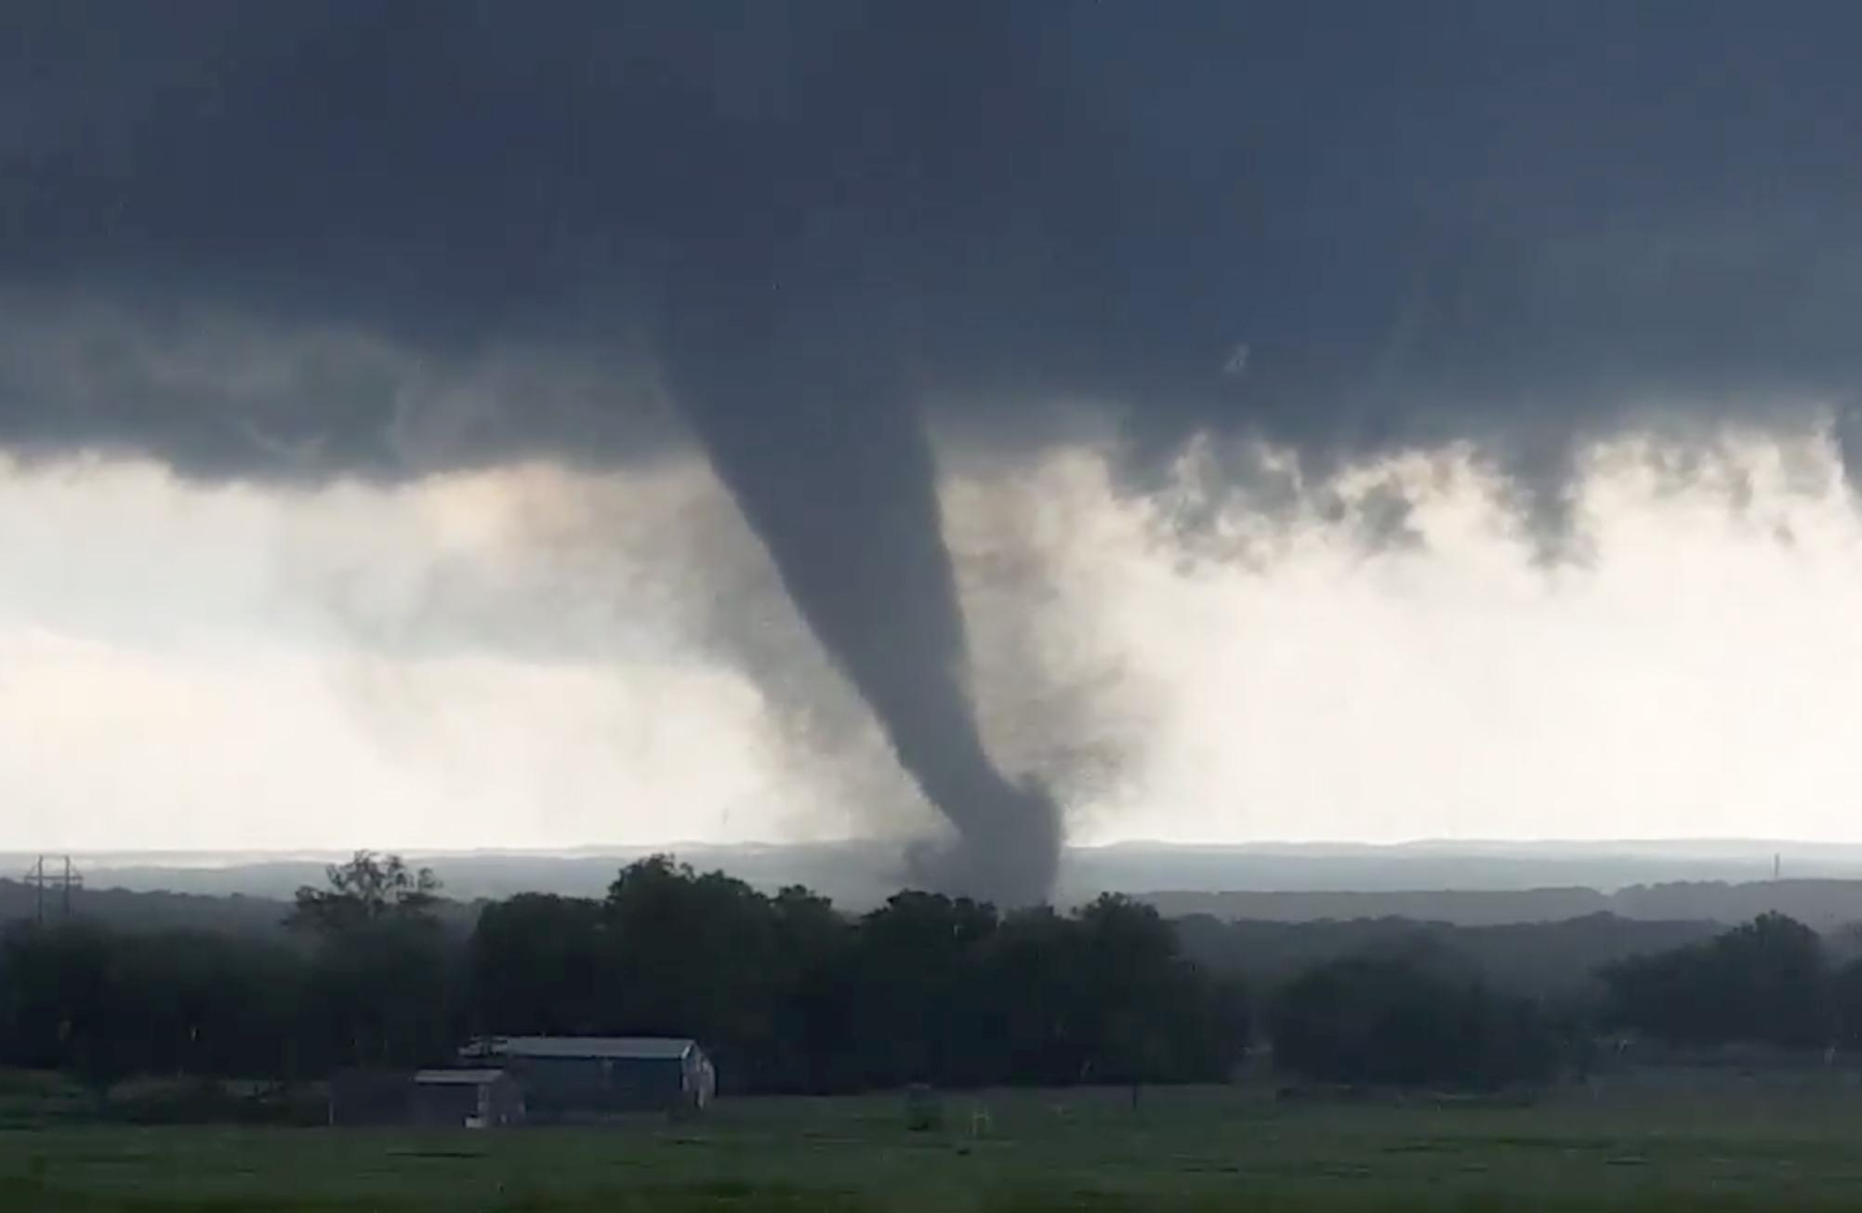
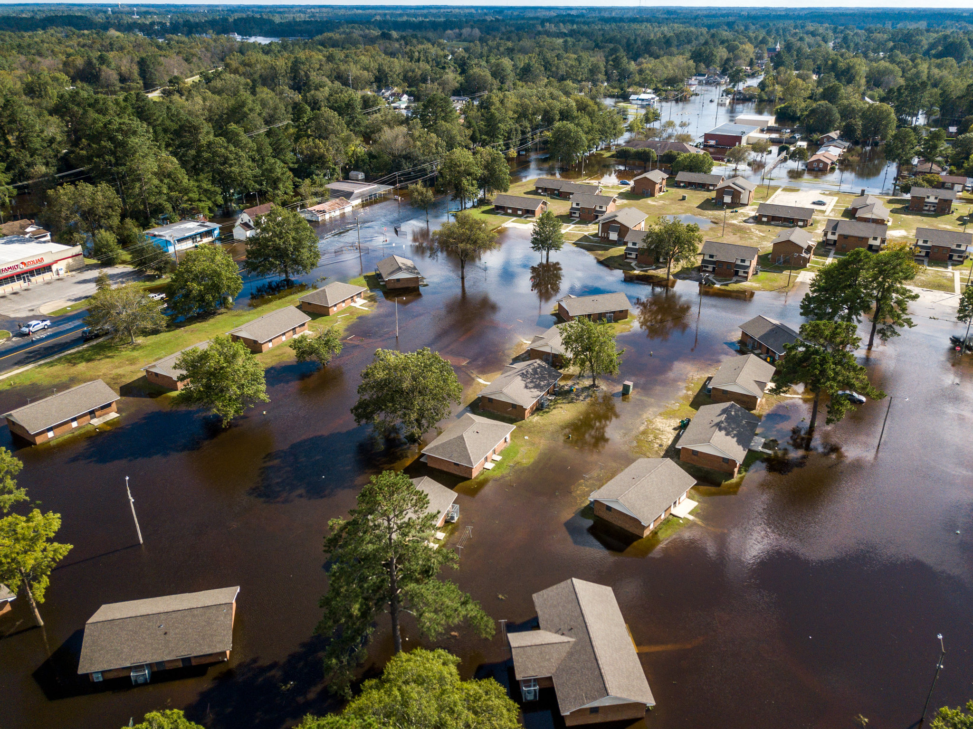
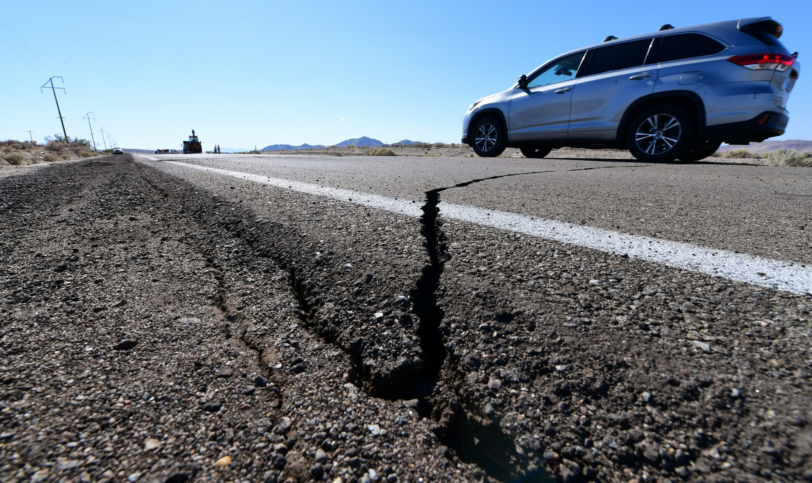
How do nature disasters affect housing prices?
Hurricane in Florida (Zivin et al., 2023)
Flood hazards in North Carolina (Bin and Landry 2013)
Earthquake in California (Fekrazad, Amir, 2019)
Tornadoes in Oklahoma (Cho et al., 2022)
(abcnews.go.com)
(The Spokesman-Review)
(msimages.org)
(Newsweek)

Slide 5
Methodology: The Hedonic price model and D-i-D
Housing Price
Time effects
Joint effects
$$lnP_{itj} = β_{0} + \sum_{i=1}^{k}{β_{j}x_{itj}} + β_{1}d_{1} + β_{2}d_{2} + β_{3}(d_{1}× d_{2} ) + ε_{itj}$$
Housing attributes
Wildfire effects
(Acreage, Age of the house, # of bedrooms, # of bathrooms, Total square feet, Garage existence, Basement existence, Good quality)

Slide 6
Overview of the Data
Source: Property Valuation Services Corporation (PVSC)
Variables | Summary statistics for the hedonic data
 | Mean | Std. dev. | Min |  | Max | C.V.
House sales price ($) | 740,700 | 531,670 | 50000 |  | 9,565,200 | 0.717
Age of house | 25.7 | 24.7 | 0 |  | 125.00 | 0.963
Number of bedrooms | 3.40 | 1.20 | 0 |  | 8 | 0.354
Total square feet | 2414.3 | 992.25 | 360 |  | 9725 | 0.410
Good quality (=1) | 0.385 | 0.486 | 0 |  | 1 | 1.26
Acreage | 0.643 | 0.957 | 0.044 |  | 12.51 | 1.48
Finished basement (=1) | 0.809 | 0.393 | 0 |  | 1 | 0.485
Garage (=1) | 0.677 | 0.467 | 0 |  | 1 | 0.689
Wildfire area (=1) | 0.331 | 0.471 | 0 |  | 1 | 1.42
Sold after wildfire (=1) | 0.526 | 0.499 | 0 |  | 1 | 0.949
Wildfire affected area
None affected area
Data source: 745 residential sales in Halifax from Jan-Dec 2023

Slide 7
Results
Variables | Estimating in OLS, , Heteroskedasticity-robust standard errors
 | Coeff. | Std. error | t-ratio | p-value
Constant | 12.84 | 0.0939 | 136.7 | 0.0000
Age of house | −0.0019 | 0.000854 | −2.239 | 0.0255
Number of bedrooms | −0.00146 | 0.0141 | −0.103 | 0.91
Total square feet | 0.000150 | 0.0000253 | 5.953 | 0.00000000407
Acreage | 0.0628 | 0.0216 | 2.904 | 0.0038
Finished basement (=1) | −0.0578 | 0.0309 | −1.866 | 0.0625
Garage (=1) | 0.0804 | 0.0325 | 2.473 | 0.0136
Good quality (=1) | 0.161 | 0.0346 | 4.655 | 0.0000385
Sold after wildfire (=1) | 0.007 | 0.007 | 0.3383 | 0.359
Wildfire area (=1) | −0.117 | 0.0561 | -2.09 | 0.036
Interaction term | 0.0163 | 0.0562 | 0.29 | 0.77
Log likelihood | −10221.8 | F (11, 733) | 50.54
R-squared | 0.426 | Adjusted R-squared | 0.418
Akaike criterion | 497.69 | Schwarz criterion | 553.0545
Hannan-Quinn | 519.0322 | Sum squared resid | 82.37960
Housing price in affected area
Housing price in none affected area

Slide 8
Results Discussion (Ⅰ)
Hedonic parameters:
For a 1,000-square-foot increase, this translates to approximately a 15% increase in the house price.
A 6.3% increase in house price for a one-unit increase in land size
A 1.91% decrease in house price for 10 years older in the age of the home
An 8% increase in house price if the property has a garage
A 16.1% increase in house price for properties considered to have good construction quality

Slide 9
Results Discussion (Ⅱ)
Wildfire:
House in area where wildfire took place have on average lower price(-11%)
There is no difference on average price of houses between before and after
The interaction term suggest no significant affect our price on the wildfire affected areas after the wildfire

Slide 10
Policy Recommendations Based on Wildfire Impact Analysis
Risk Assessment and Management
Building Codes and Standards
Insurance and Financial Instruments
Public Awareness and Preparedness
Investment in Emergency Services

Slide 11
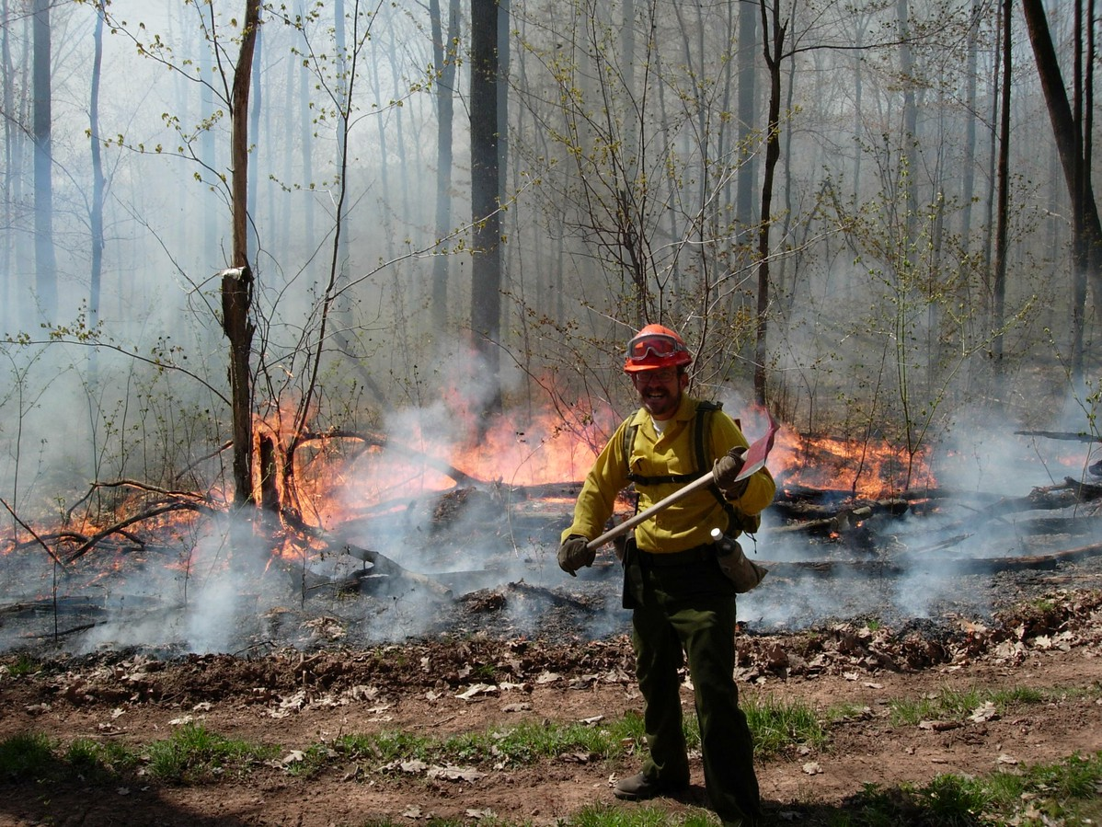
Questions?

Slide 12
References
Bin, Okmyung, and Craig E. Landry. 2013. “Changes in Implicit Flood Risk Premiums: Empirical Evidence from the Housing Market.” Journal of Environmental Economics and Management 65 (3): 361–76. https://doi.org/10.1016/j.jeem.2012.12.002.
Cho, W., Whitacre, B. E., & Rhoades, C. A. (2022). The Effects of Tornadoes on Housing Prices in Moore, Oklahoma. The Review of Regional Studies, 52(1). https://doi.org/10.52324/001c.34682.
Fekrazad, Amir. 2019. “Earthquake-Risk Salience and Housing Prices: Evidence from California.” Journal of Behavioral and Experimental Economics, February. https://doi.org/10.1016/j.socec.2019.01.001.
Zivin, Joshua Graff, Yanjun Liao, and Yann Panassié. 2023. “How Hurricanes Sweep up Housing Markets: Evidence from Florida.” Journal of Environmental Economics and Management 118 (March): 102770. https://doi.org/10.1016/j.jeem.2022.102770.

