Slide 1
Canada’s Bottom line
The State of the Economy and Government Finances
Ottawa, November 2024
Presentation to
OEA/CABE

Slide 2
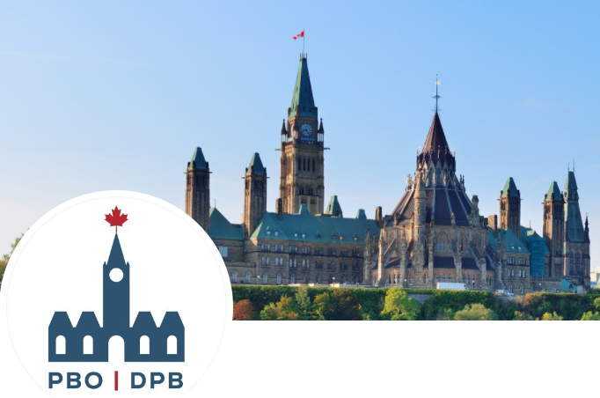
Why is the PBO doing this work?
The PBO is an independent Agent of Parliament mandated to provide non-partisan economic and fiscal analysis
Reliable, Trustworthy Information

Slide 3
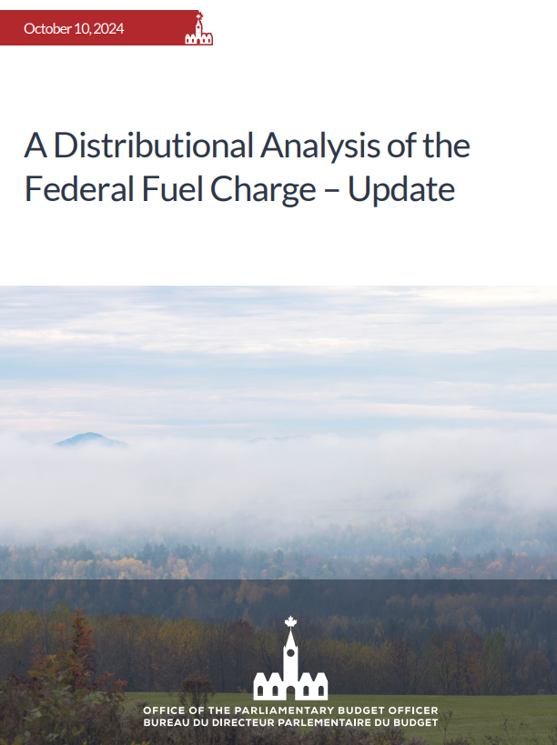
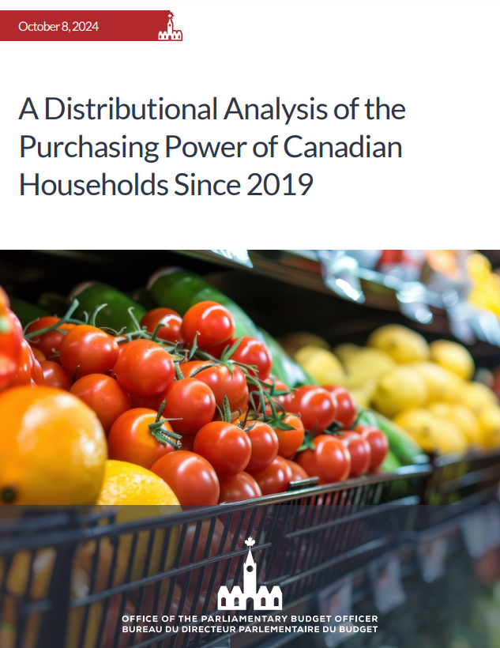
Recent Reports

Slide 4
Economic and Fiscal Outlook October 2024

Slide 5
PBO’s October Economic Outlook
Per cent (unless otherwise stated)
Incorporates data up to and including October 1, 2024.

Slide 6
PBO’s October Economic Outlook
Per cent (unless otherwise stated)
Incorporates data up to and including October 1, 2024.

Slide 7
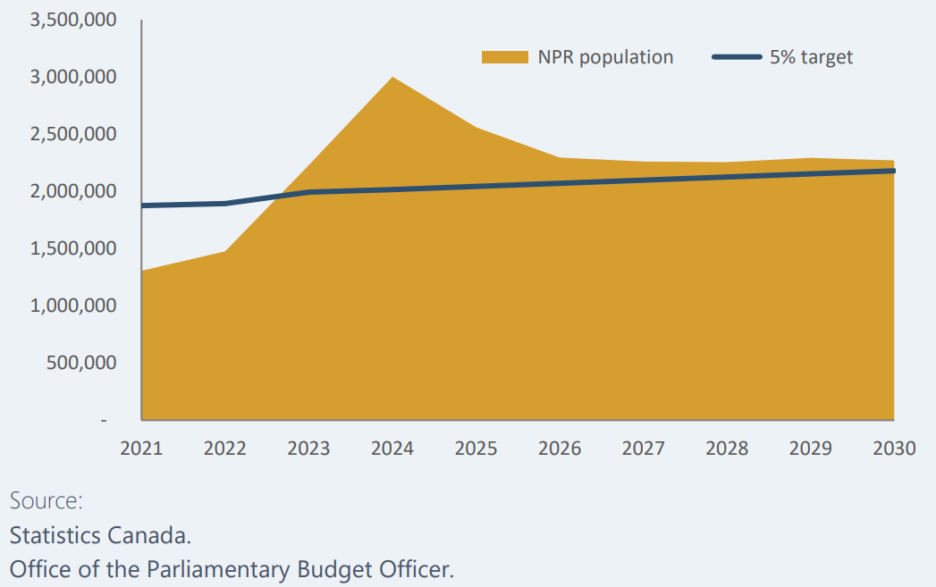
PBO’s Baseline Scenario for the Non-Permanent Resident (NPR) Population

Slide 8
New Immigrants to Canada - Median Total Income Ratio 1 Year After Entry
Source:
Statistics Canada, Tables 43-10-0027, 18-10-005, and 11-10-0055.

Slide 9
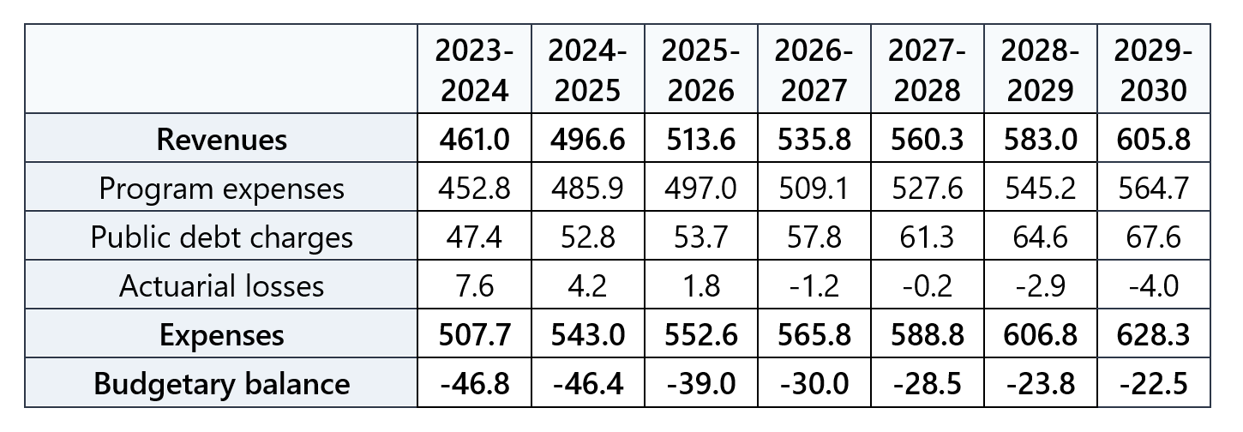
PBO’s October Fiscal Outlook
Billions of dollars (unless otherwise stated)

Slide 10
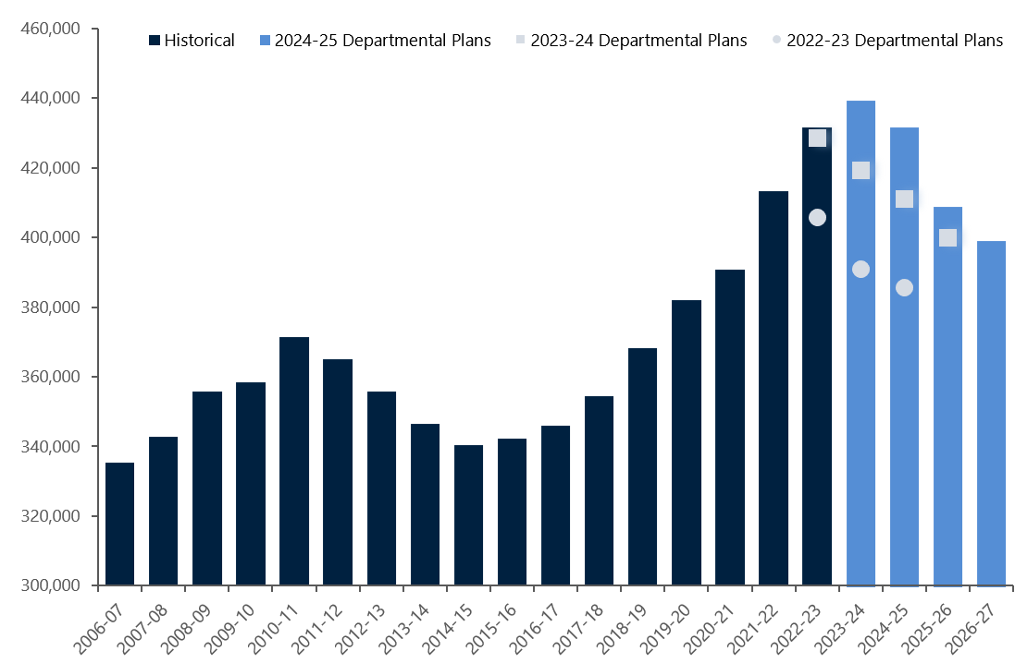
Full-Time Equivalents in the Federal Public Service

Slide 11
PBO’s October Fiscal Outlook
Billions of dollars (unless otherwise stated)

Slide 12
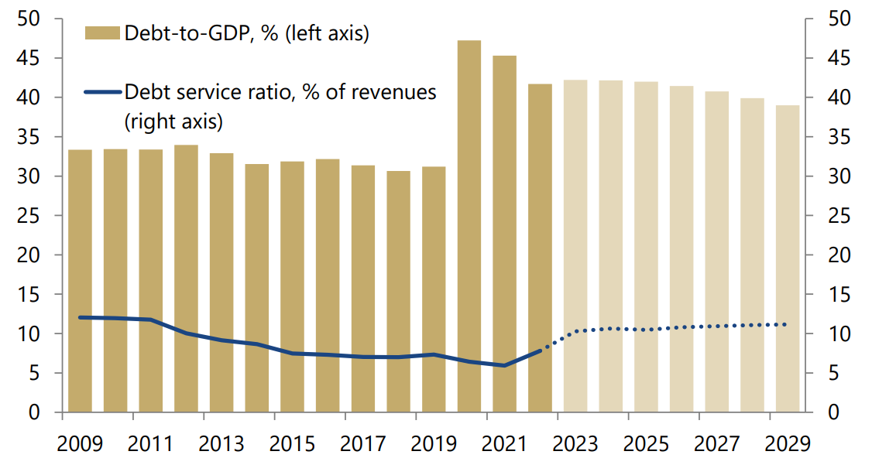
PBO’s October Fiscal Outlook Federal Debt and Debt Service Ratios

Slide 13
The Fiscal Implications of Meeting the NATO Military Spending Target
Hypothetical forecast of deficit-to-GDP ratio versus baseline

Slide 14
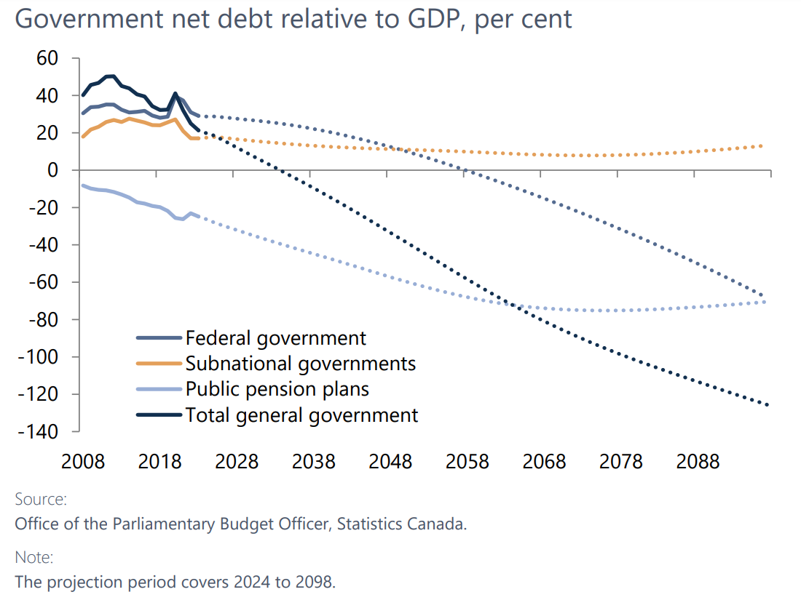
Fiscal Sustainability - 2024

Slide 15
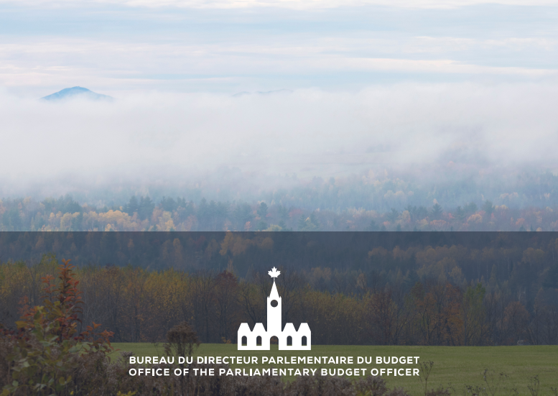
Risks and Uncertainty
Interest rates
Geopolitical tensions
Household spending

Slide 16
Recent and Upcoming Reports
Trans Mountain Pipeline – 2024 Report
Update on Federal Housing
Guaranteed Basic Income
Analysis of the Government’s Fall Statement and Estimates
Election Proposal Costing…

Slide 17
www.pbo-dpb.ca
pbo-dpb@parl.gc.ca

